Slide 1
Optical Integrated Circuits Integrated Photonics

Slide 2
Contents:
Dielectric waveguides (Electromagnetic Theory)
Coupling Mode Theory
Elementary Integrated Photonic Devices
Fiber to Waveguide Coupling
Waveguide Loss
Waveguide Fabrication
Applications

Slide 3
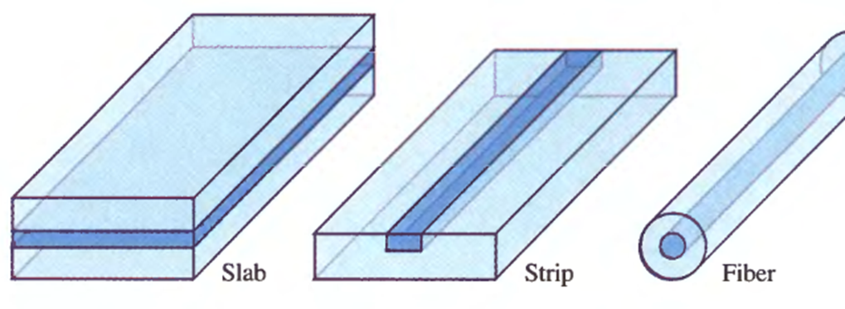
Dielectric waveguide (Electromagnetic Theory)
Planer Waveguides
Effective Index & Effective Index Method
Channel Waveguides
Graded Index Waveguides

Slide 4
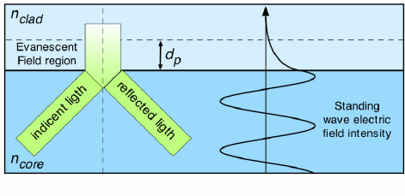
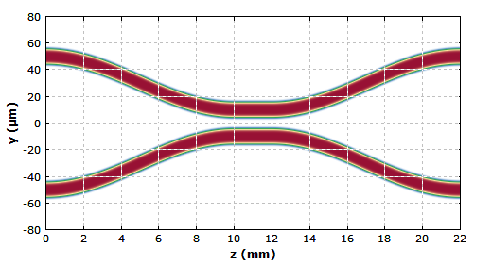
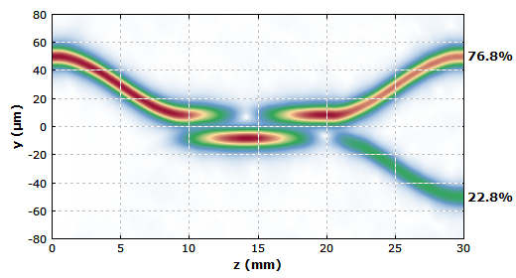
Coupling Mode Theory
Evanescent Fields
Optical Directional Coupler

Slide 5
Elementary Integrated Photonic Devices
Mach-Zehnder
Directional Coupler
Optical Taper
Micro-cavities
Micro-rings
Gratings & Photonic Crystals
Plasmonic & Nano-photonic Devices
Electro-optic Devices

Slide 6
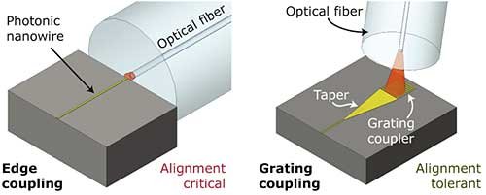
Fiber to Waveguide Coupling
Fiber to Waveguide Coupling

Slide 7
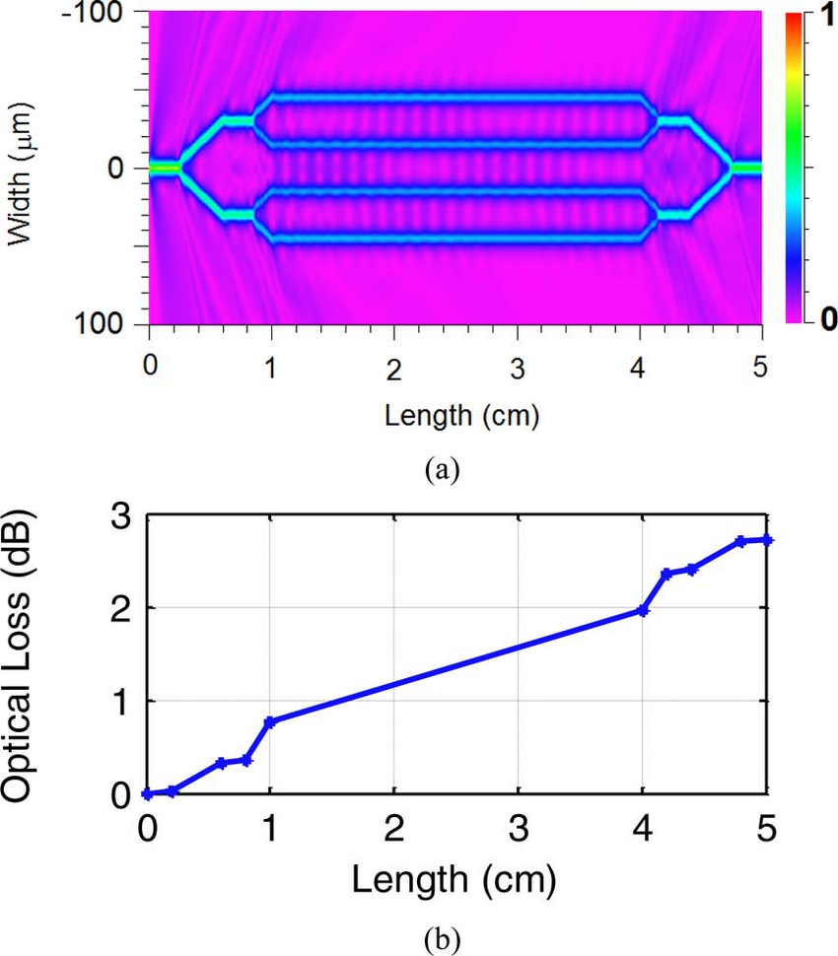
Waveguide Loss

Slide 8
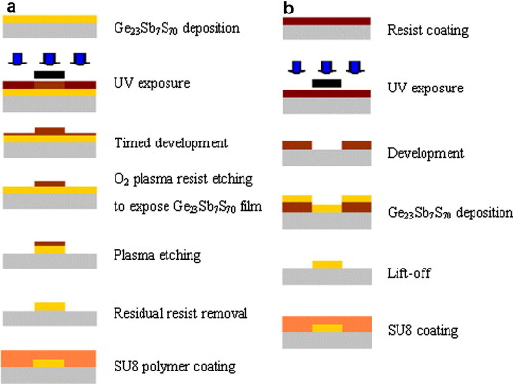
Waveguide Fabrication

Slide 9
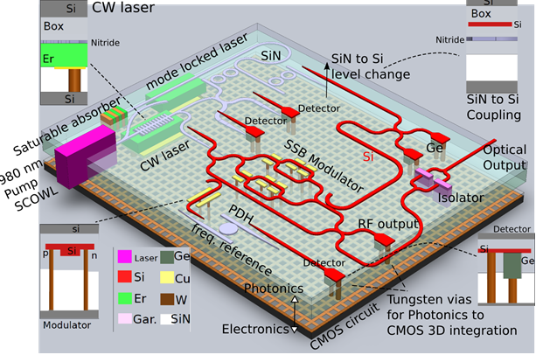
Applications
Sensors
Communication
Opto-mechanic
Quantum Optics

